Slide 1
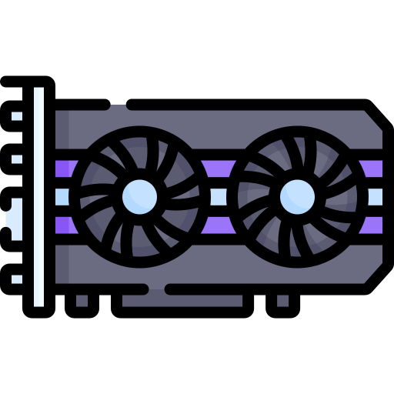
U-Net Parallelizing

Slide 2
TABLE OF CONTENTS
01
02
U-Net Architecture
Sequential draft
03
04
Parallel draft
Other Components

Slide 3
01
WHAT IS U-Net?

Slide 4
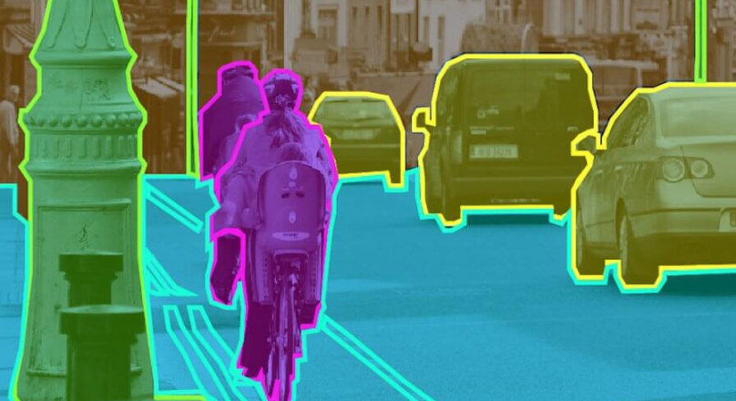
U-Net Architecture
U-Net is a neural network architecture designed for a task called semantic segmentation.
In simpler terms, it's a technique to take an image and automatically identify different parts within it.
Semantic Segmentation [1]

Slide 5
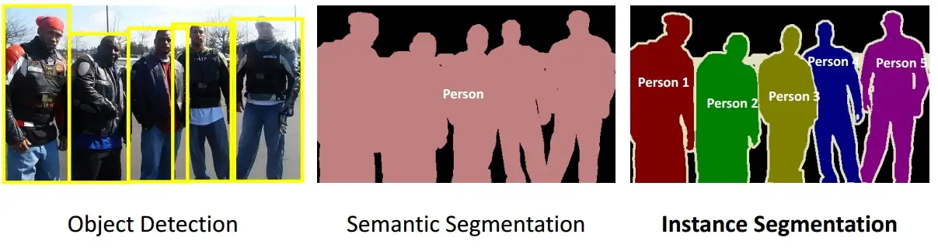
U-Net Architecture
In semantic segmentation, each pixel in an image is assigned a label that corresponds to the object or class it belongs to.

Slide 6
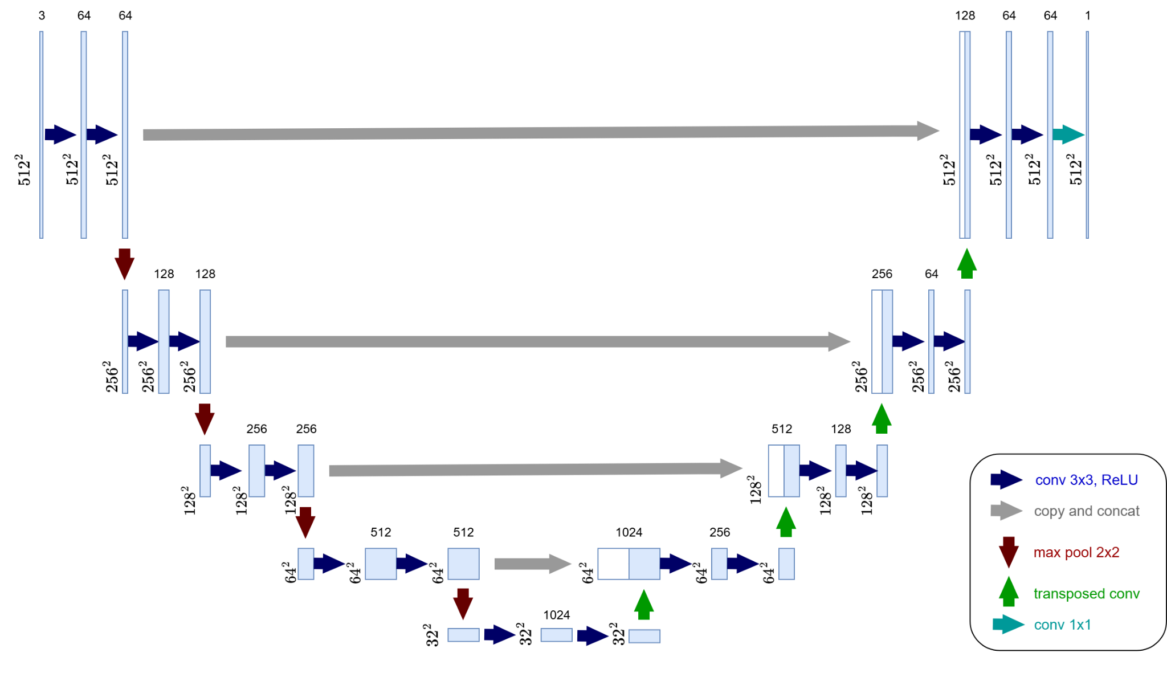
U-Net Architecture

Slide 7
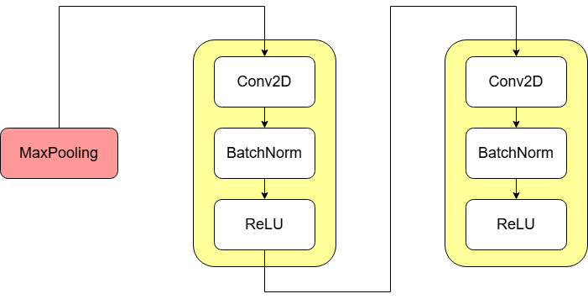
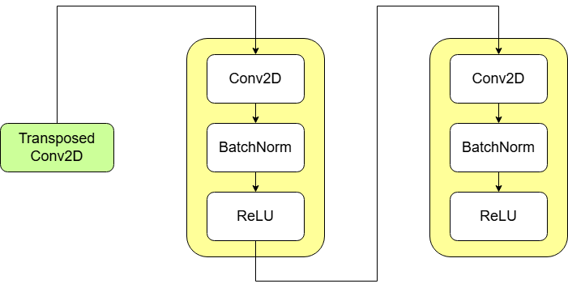
U-Net Architecture
Downsampling block
Upsampling block

Slide 8
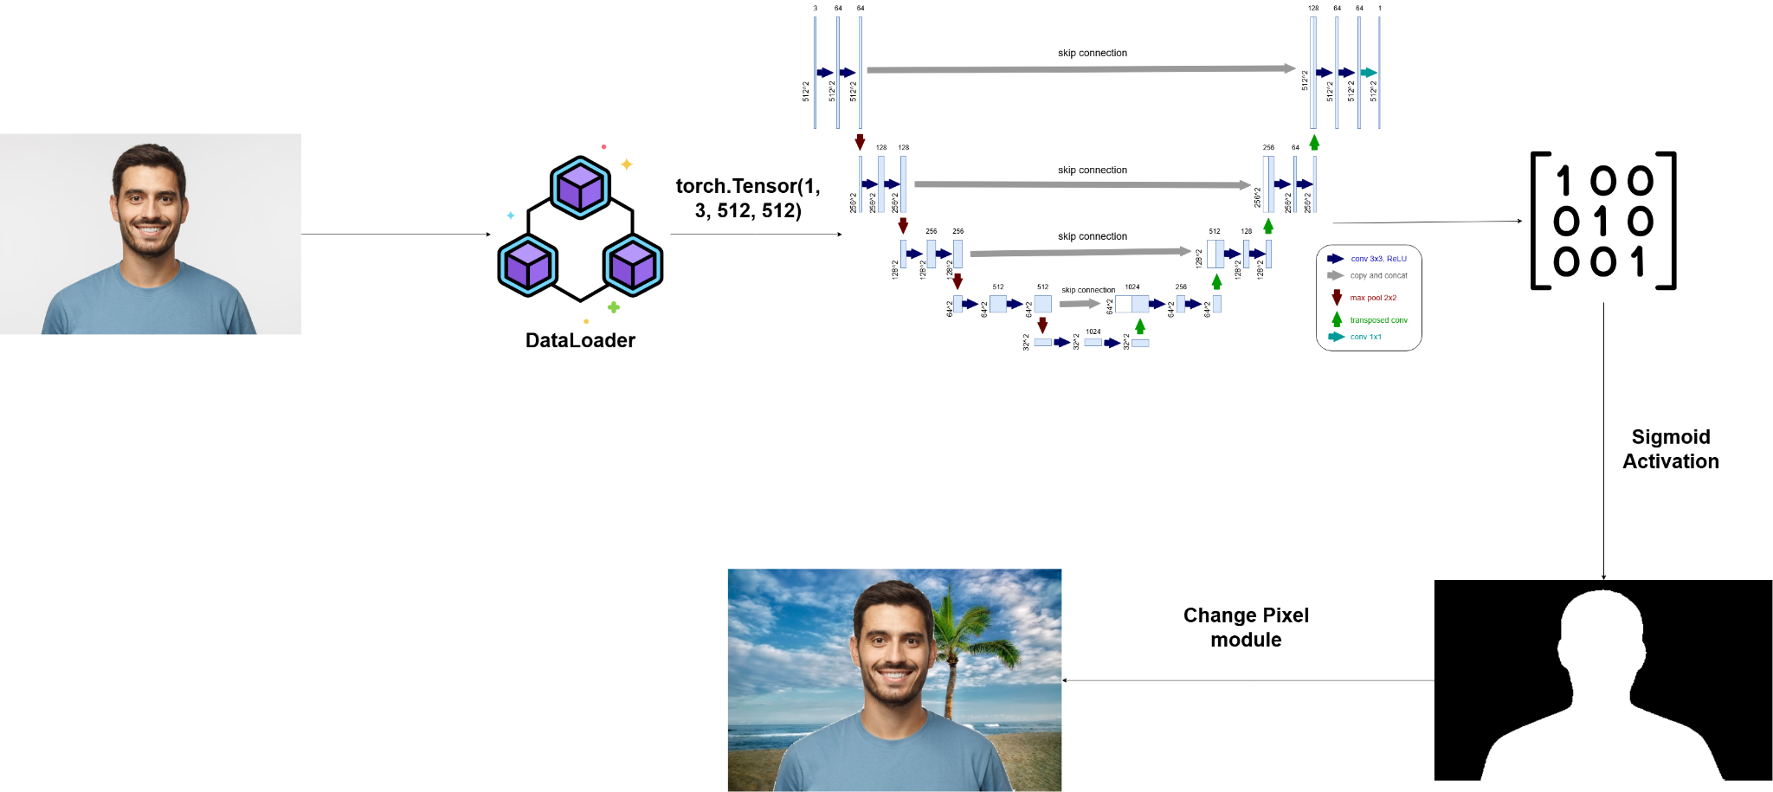
Workflow

Slide 9
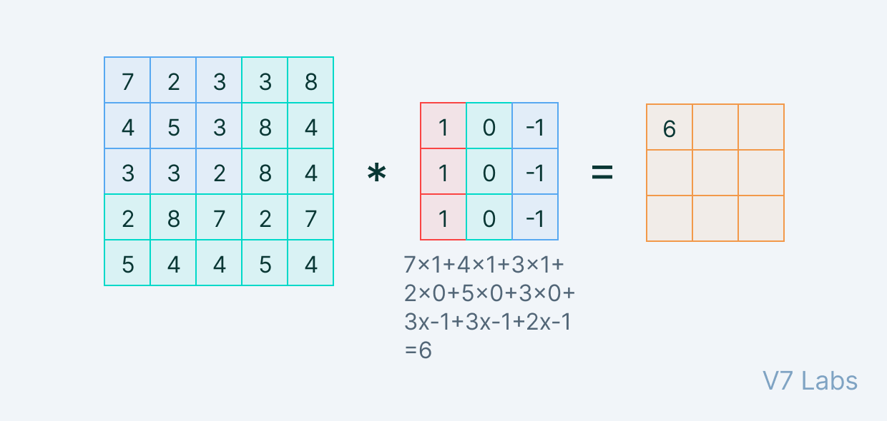

Convolutional Layer
Convolutional Layer [3]

Slide 10
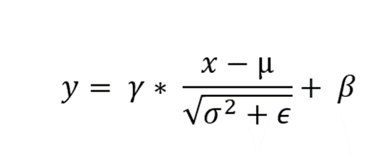
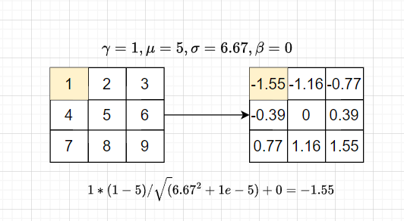
Batch Normalization
Within:
γ is the weight of model
β is the bias of model
μ is mean value
σ is variance
ε equal to 1e-5

Slide 11
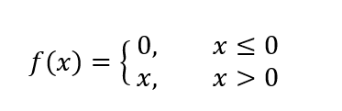
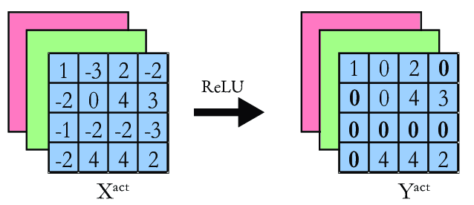
ReLU Activation
ReLU Activation [4]

Slide 12
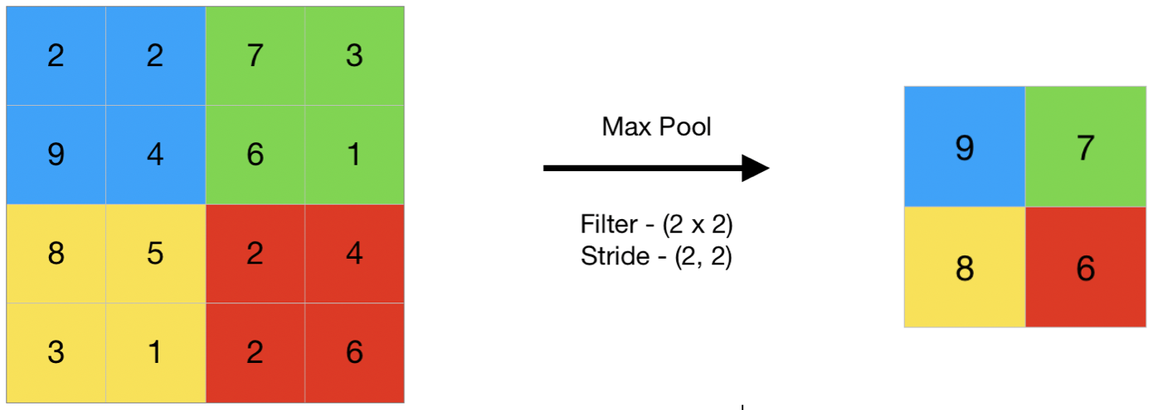
Max Pooling
Max Pooling Kernel [5]

Slide 13
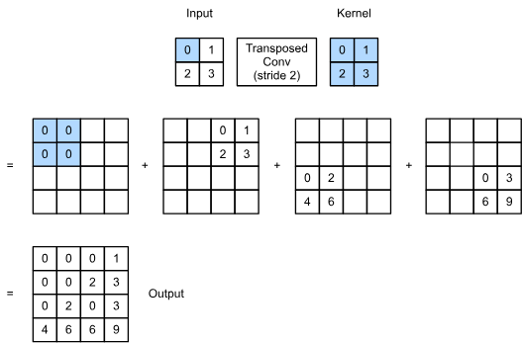
Transposed Convolution
Kernel size = 2 x 2
Padding = 0
Stride = 2
Transpose Convolution Kernel [6]

Slide 14
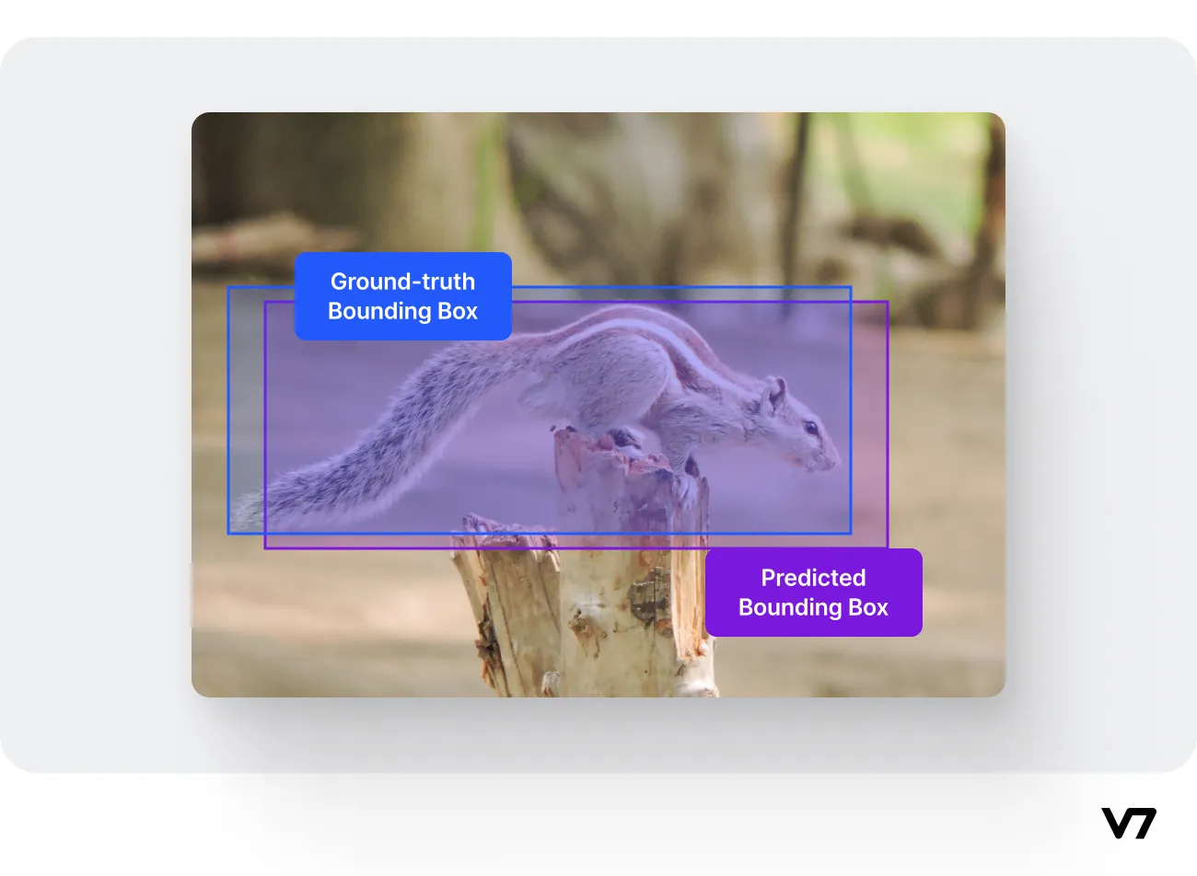
Intersection over Union (IoU)
Intersection over Union is a metric to measure localization accuracy and compute localization errors.
It calculates the amount of overlapping between two bounding boxes—a predicted bounding box and a ground truth bounding box.

Slide 15

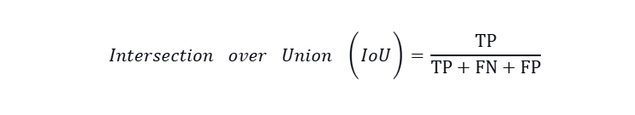
Intersection over Union (IoU)
Mathematically
Binary classification

Slide 16
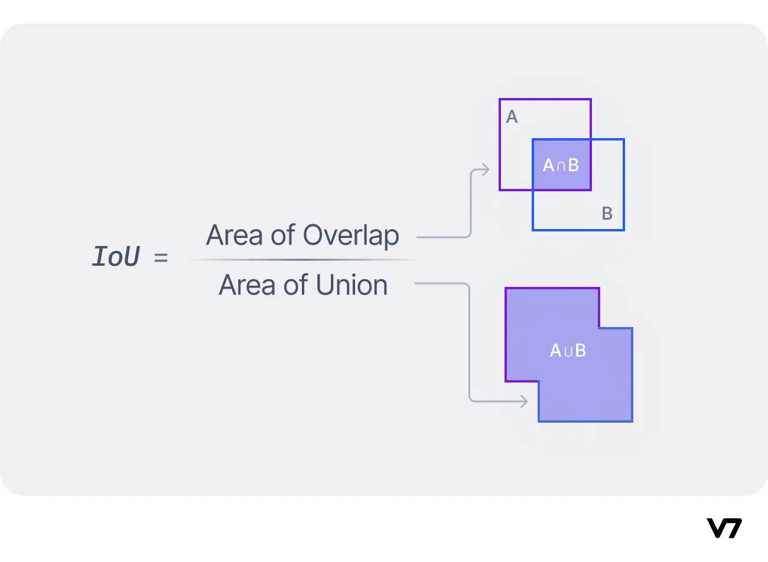
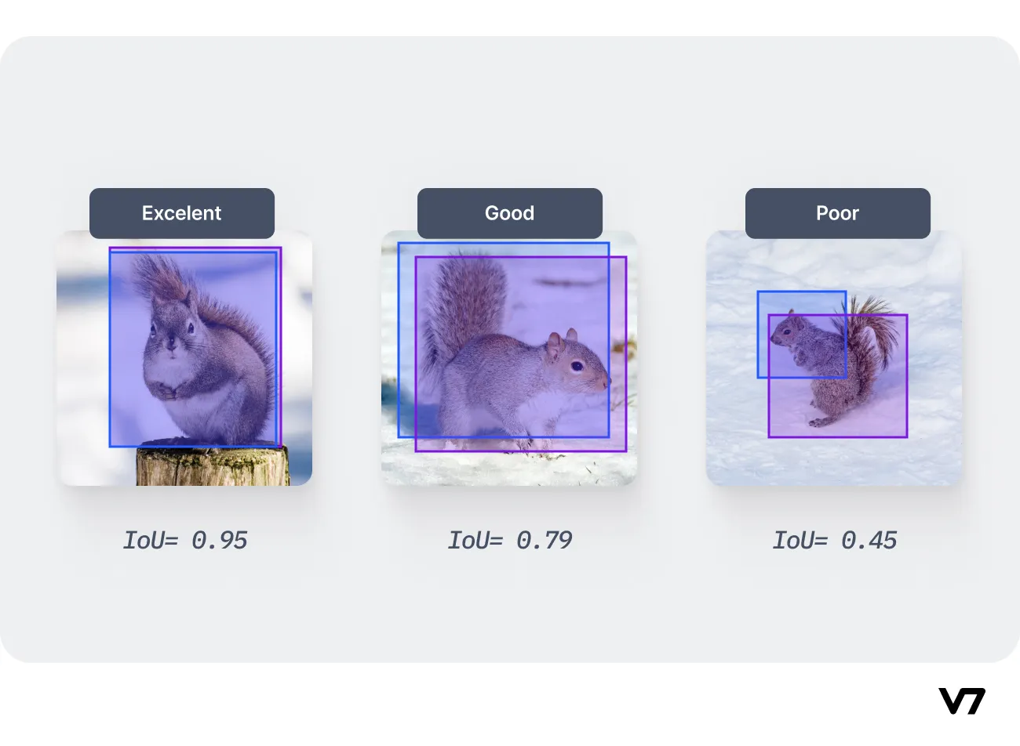
Intersection over Union (IoU)
Ideas

Slide 17
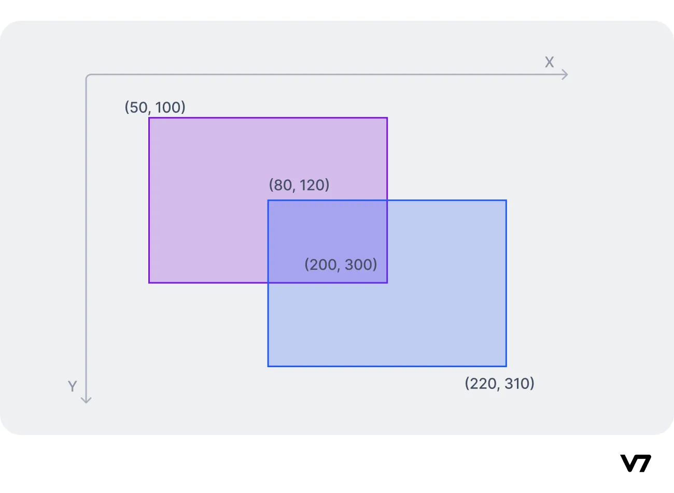
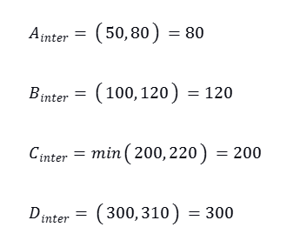
Intersection over Union (IoU)
Calculating

Slide 18
Intersection over Union (IoU)
Table of IoU measuring for 10k images test data.
Thresholds | 0.1 | 0.3 | 0.5
IoU | 0.956 | 0.965 | 0.965

Slide 19
02
Sequential Draft

Slide 20
Double Convolutional Layer
Idea
Perform the straightforward convolution operation.
 | down1 | down2 | down3 | down4 | down5
Runtime (secs) | 514 | 321 | 221 | 147 | 117
Difference | e-07 | e-03 | e-03 | e-03 | e-03

Slide 21
Transposed Convolutional Layer
Idea
Perform the straightforward convolution operation.
 | up1 | up2 | up3 | up4 | up5
Runtime (secs) | 489 | 321 | 203 | 121 | 74
Difference | e-06 | e-03 | e-03 | e-02 | e-02

Slide 22
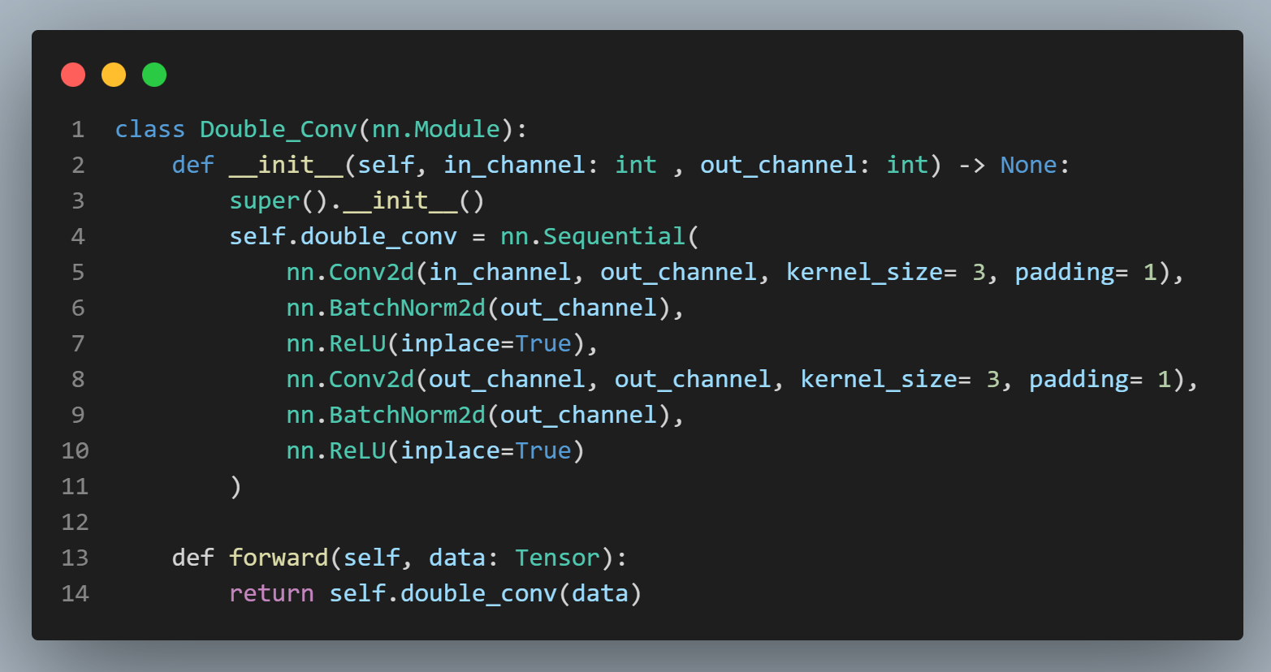
Double Convolutional Layer

Slide 23
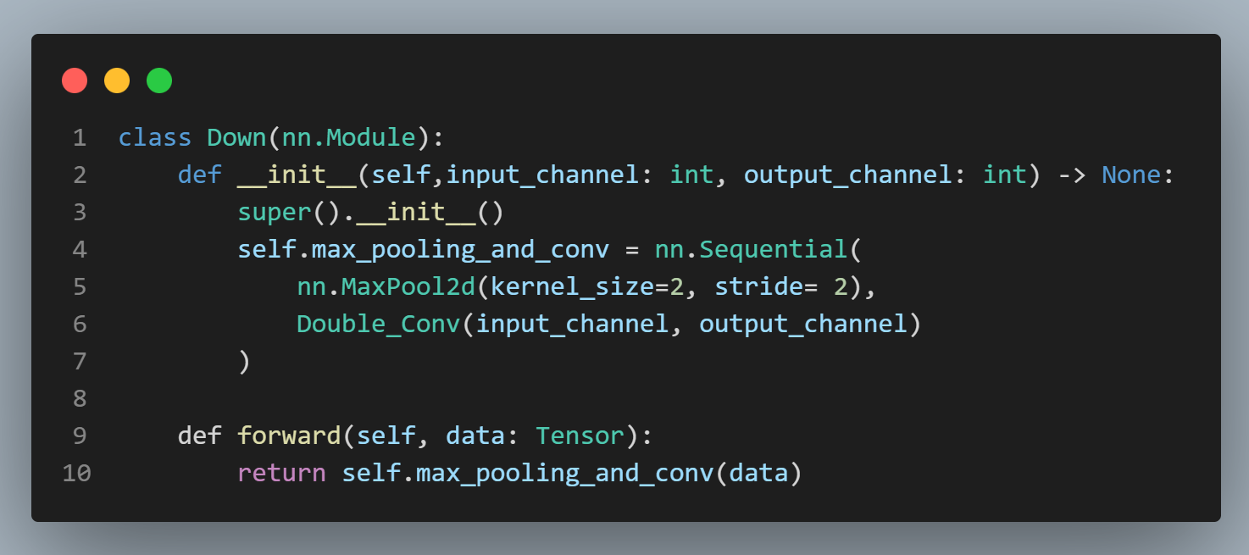
Down Layer

Slide 24
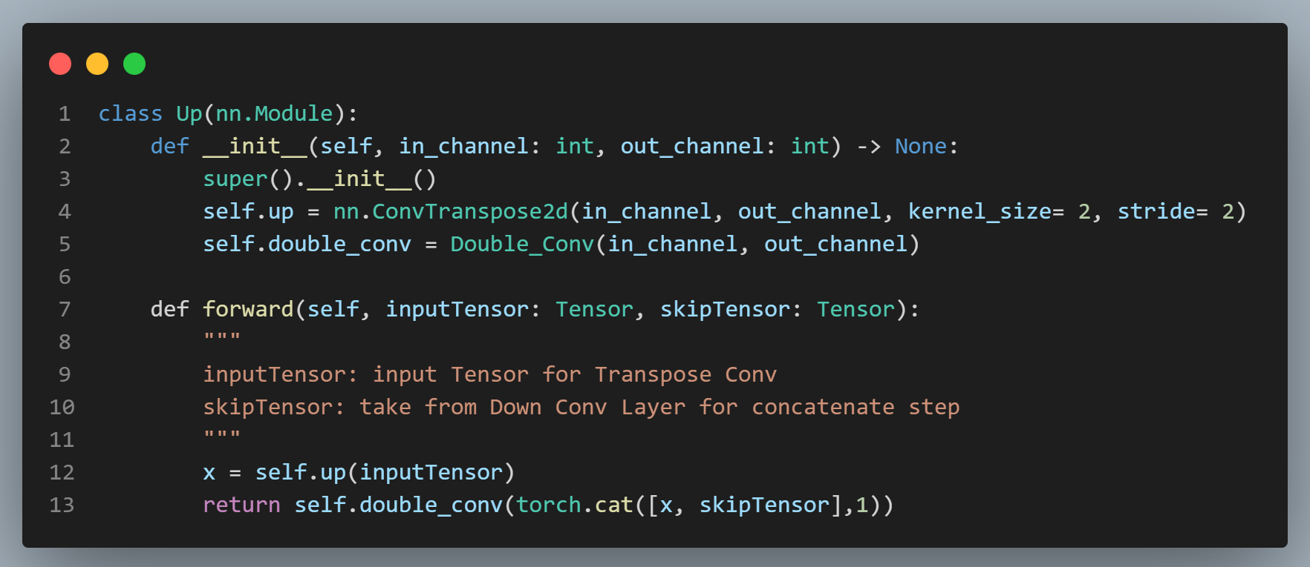
Up Layer

Slide 25
03
Parallel Draft

Slide 26
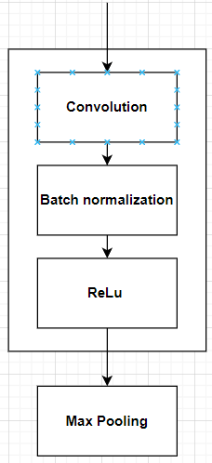
Parallelizing
Just focus on inference phases not a whole training process.
Convolutional layers
Batch Normalization
ReLU Activation
Max Pooling

Slide 27
BatchNorm2D
Idea
Each thread is responsible for normalizing one pixel of the output.
We also move weight, bias, mean, var from host to constant memory for faster computation.
Blocks and Grid
1D block with size 256.
3D grid: X handle dimensions of entire image and channel out, Z axis manages batch.

Slide 28
BatchNorm2D
Input Size (C, H, W) | Sequential Runtime (s) | Numba Runtime (s) | Different
(64, 512, 512) | 31.22 | 0.34 | 0.0
(128, 256, 256) | 24.84 | 0.28 | 0.0
(256, 128, 128) | 13.41 | 0.24 | 0.0
(512, 64, 64) | 7.89 | 0.26 | 0.0

Slide 29
ReLU
Idea
Each thread performs the ReLU activation on single pixel of the output.
Blocks and Grid
1D block with size 256.
3D grid: X and Y handle dimensions of entire image, Z axis manages batch and out channel.

Slide 30
ReLU
Input Size | Sequential Runtime | Numba Runtime | Different
(64, 512, 512) | 7.82 | 0.273 | 0.0
(128, 256, 256) | 4.23 | 0.261 | 0.0
(256, 128, 128) | 2.38 | 0.254 | 0.0
(512, 64, 64) | 1.13 | 0.236 | 0.0

Slide 31
Max Pooling
Idea
Each thread handles the computation of the maximum value in a specific pooling region of the feature map.
Block and Grid
1D block with size 256.
3D grid: X handle dimensions of entire image and channel out, Z axis manages batch.

Slide 32
Max Pooling
Input Size | Sequential Runtime (s) | Numba Runtime (s) | Different
(64, 512, 512) | 9.61 | 0.34 | 0.0
(128, 256, 256) | 6.42 | 0.29 | 0.0
(256, 128, 128) | 4.06 | 0.301 | 0.0
(512, 64, 64) | 2.42 | 0.287 | 0.0

Slide 33
Version 1: Tile Shared Convolution
Idea
Using shared memory for input tiles, reducing global memory accesses and boosting performance.
Each thread copy one pixel of the input to shared memory then performs convolution operator on one pixel of the output.
Blocks and Grid
2D Block with size (16x16).
3D grid: X and Y handle dimensions of entire image, Z axis manages batch and channel out.

Slide 34
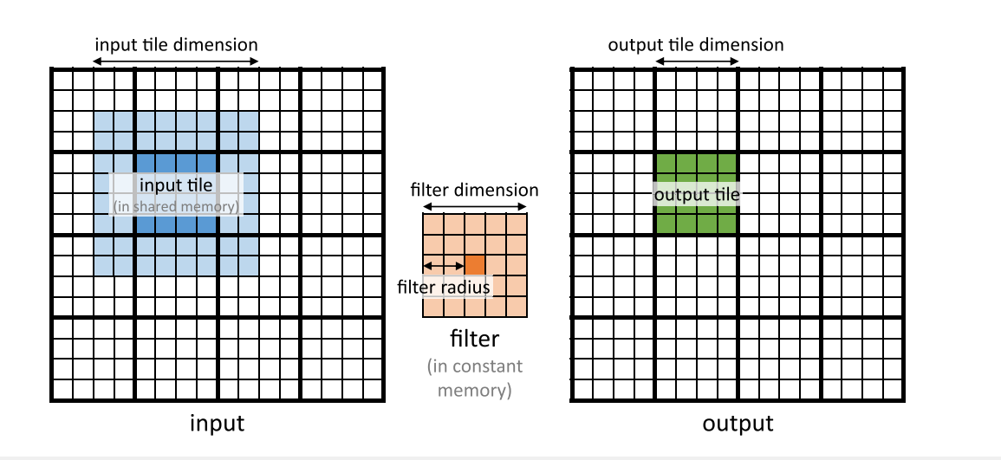
Version 1: Tile Shared Convolution
Tile 2D convolution [7]

Slide 35
Version 1: Tile Shared Convolution
Layer (channel in * channel_out) | Sequential Runtime (s) | Numba Runtime (s) | Different
3 x 64 | 219.56 | 0.213 | 2.8e-6
64 x 128 | 147.26 | 0.205 | 0.0016
128 x 256 | 102.09 | 0.203 | 0.0023
256 x 512 | 58.33 | 0.196 | 0.003
512 x 1024 | 44.31 | 0.232 | 0.0046

Slide 36
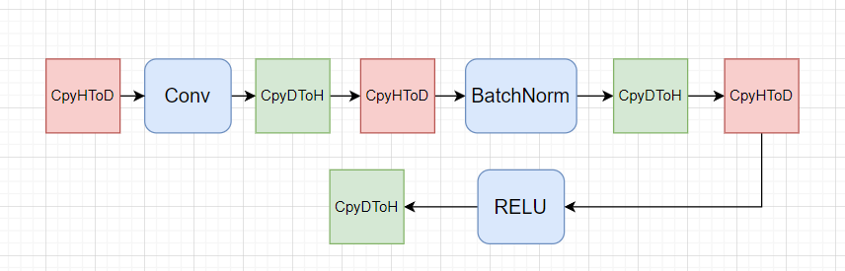
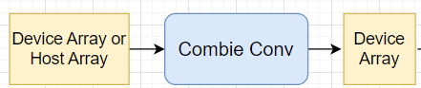
Version 2: Combine Conv, BatchNorm2d, ReLU
Original
Optimized

Slide 37
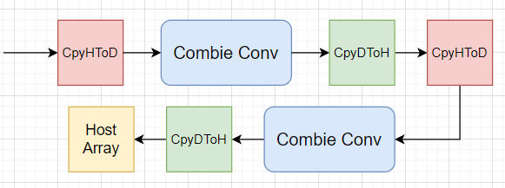
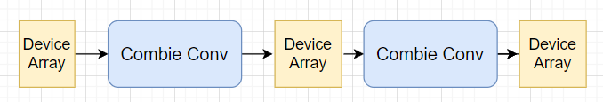
Version 3: Reduce data transfer
Original:
Optimized

Slide 38
Version 3: Reduce data transfer
Table of the number of data transfer between host and device.
Block | Down 1 | Down 2 | Down 3 | Down 4 | Down 5 | Up 1 | Up 2 | Up 3 | Up 4 | Out | Total
Original (transfer) | 12 | 16 | 16 | 16 | 16 | 16 | 16 | 16 | 16 | 2 | 142
Optimized (transfer) | 1 | 0 | 0 | 0 | 0 | 1 | 1 | 1 | 1 | 1 | 6

Slide 39
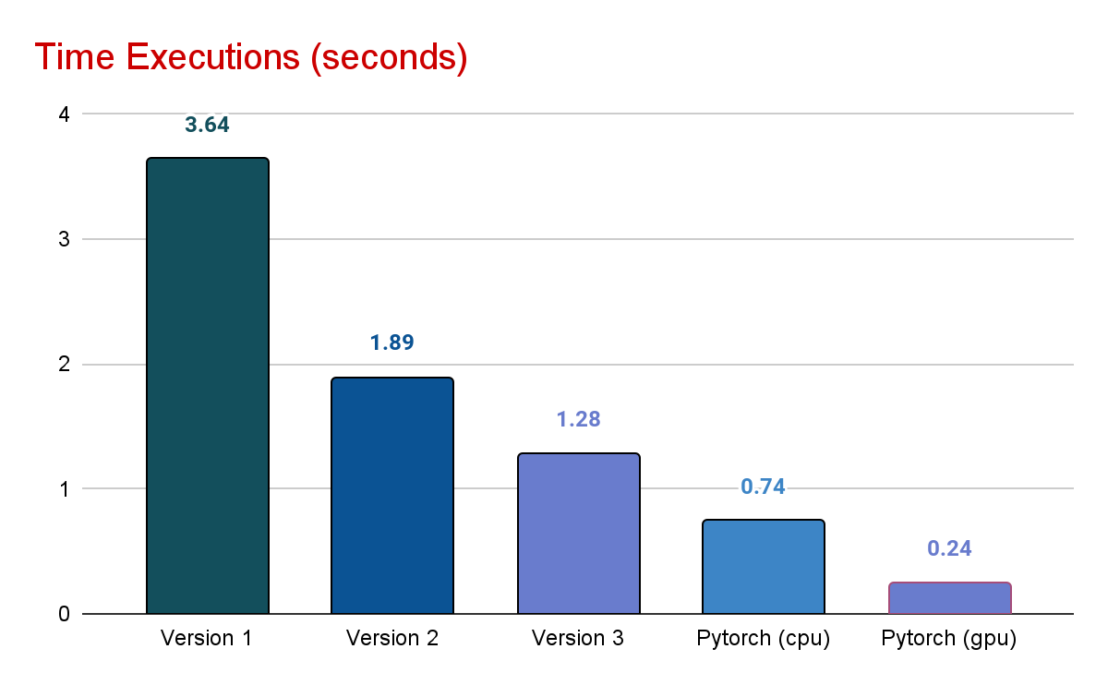
Comparison

Slide 40
Comparison
Table of differences between GPU Numba versions compare to Pytorch.
 | Version 1 | Version 2 | Version 3
Difference (pytorch) | 0.004 | 0.0047 | 0.005

Slide 41
04
Other Components

Slide 42
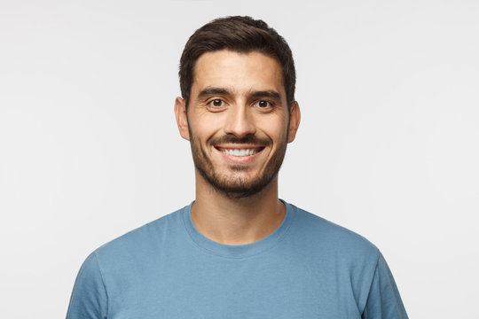


PORTRAIT SEGMENTATION

Slide 43


PORTRAIT MATTING

Slide 44
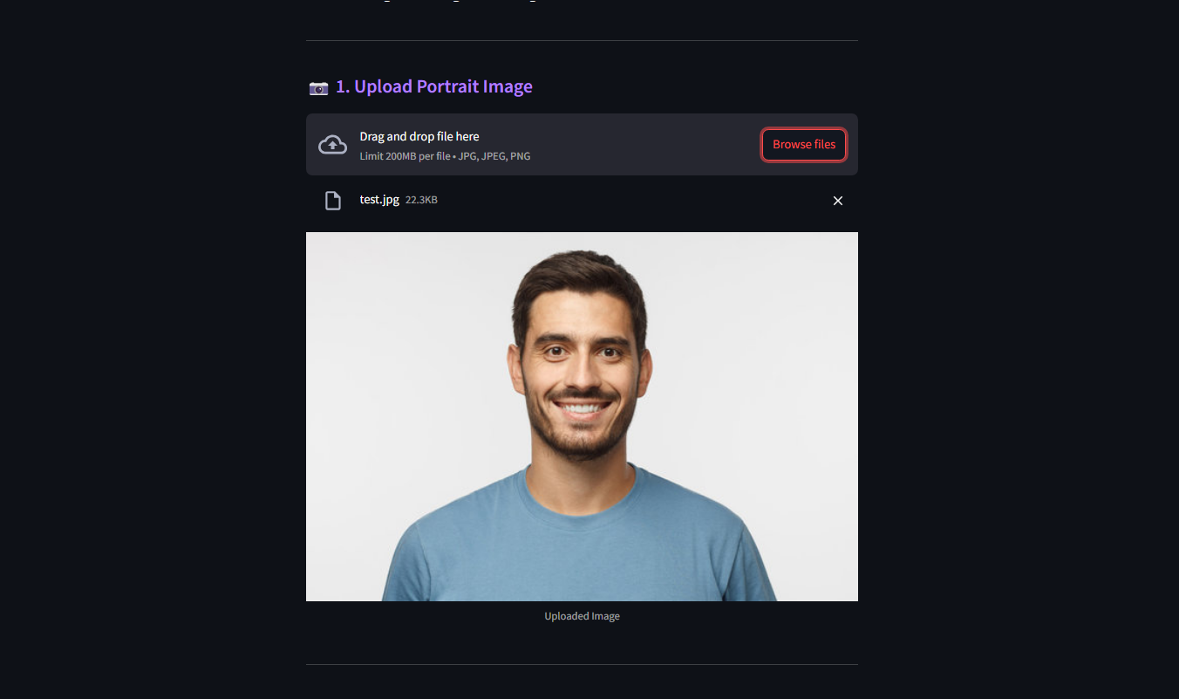

WEB INTERFACE
Import image

Slide 45


WEB INTERFACE
Change background

Slide 46
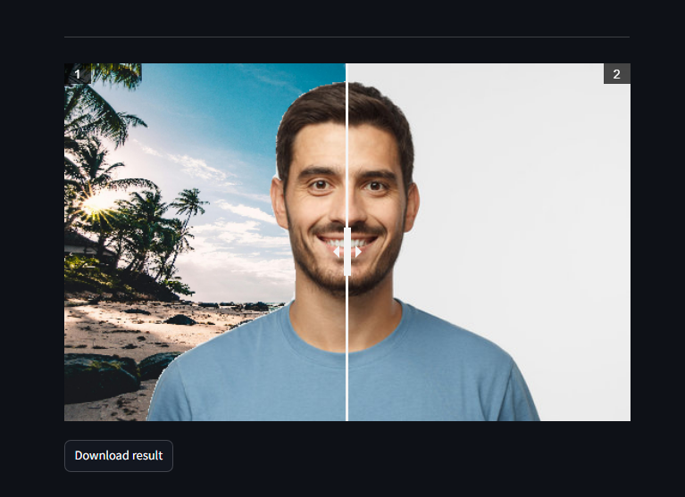


WEB INTERFACE
Compare old & new portrait
Download results

Slide 47
Challenges
Integration of Numba and PyTorch.
Limitations of document.
High parameters.
Lack of suitable Pre-trained model for this task.

Slide 48

Goal and Deliverables
Milestone 75%
Successfully performing the masking on portrait image.
Some problems can happen:
Execute slower than the baseline.
Acceptable for low resolution image.

Slide 49
Goal and Deliverables
Milestone 100%
Performing with at least 2 times faster than the sequential approach on segmentation task.
Successfully implementing the background replacement module.
Acceptable for high resolution image.

Slide 50

Goal and Deliverables
Milestone 125%
Implementing the replacing the recorded video background.

Slide 51
Future Plans
Performing with at least equivalent to the Pytorch core approach.
Implementing the replacing the recorded video background.
Tackle the real-time data.
Deploy a web interface with various useful features.

Slide 52
Weekly Schedule
Week 01 | Week 02 | Week 03 | Week 04
Group Initiation Finding topics | Researching original paper Seeking for datasets and library-based implementation | Looking for datasets and writing Data Loader module Training the pre-trained model | Preparing for the seminar

Slide 53
Weekly Schedule
Week 05 | Week 06 | Week 07 | Week 08
Implementing the Portrait matting algorithm | Performing sequential version with @jit decorator Analyzing the certain version and proposing the solutions | Performing parallel version with @CUDA jit decorator Analyzing the certain version and proposing the solution | Repeating the process: Analyze → Design → Implement → Evaluate.

Slide 54
Weekly Schedule
Week 09 | Week 10 | Week 11 | Week 08
Implementing the Portrait matting algorithm | Performing sequential version with @jit decorator Analyzing the certain version and proposing the solutions | Performing parallel version with @CUDA jit decorator Analyzing the certain version and proposing the solution | Repeating the process: Analyze → Design → Implement → Evaluate.

Slide 55
References
[1]
[2]
[3]
[4]
[5]
[6]
[7]
https://www.carierista.com/storage/company-posts/82/266769da4e5df45ec3a5d6947aba04dc.jpg
https://cdn.prod.website-files.com/5d7b77b063a9066d83e1209c/60ee0997d855cc0b39f6ecae_convolutional-layer.png
https://www.researchgate.net/profile/Kamel-Abdelouahab/publication/331800773/figure/fig5/AS:895112288690177@1590422808598/Example-of-ReLU-activation-function.png
https://www.geeksforgeeks.org/cnn-introduction-to-pooling-layer/
https://d2l.ai/chapter_computer-vision/transposed-conv.html
https://ars.els-cdn.com/content/image/3-s2.0-B9780323912310000082-f07-11-9780323912310.jpg

Slide 56
THANK YOU!
DO YOU HAVE ANY QUESTIONS?

